Slide 1
CSE 474 - Group 14
Shamir Roy - 20241015
Tanzim Rahman Sabib - 23141078
ST FARAH
RA AMIT
Page - 01

Slide 2
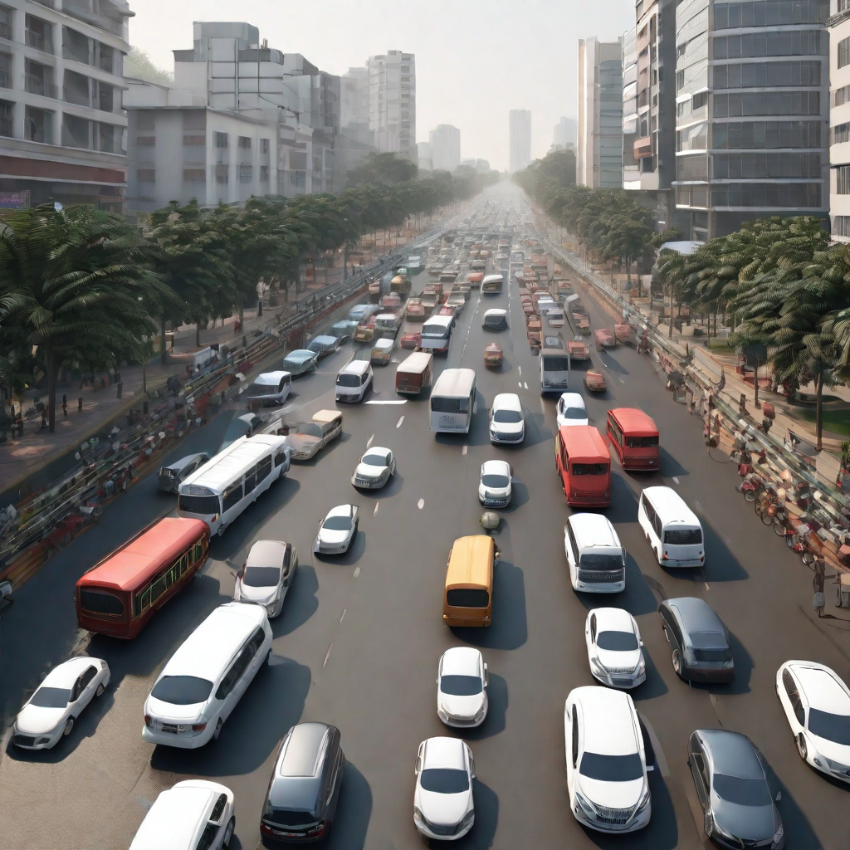
Simulating Traffic Flow in Dhaka City
Page - 02

Slide 3
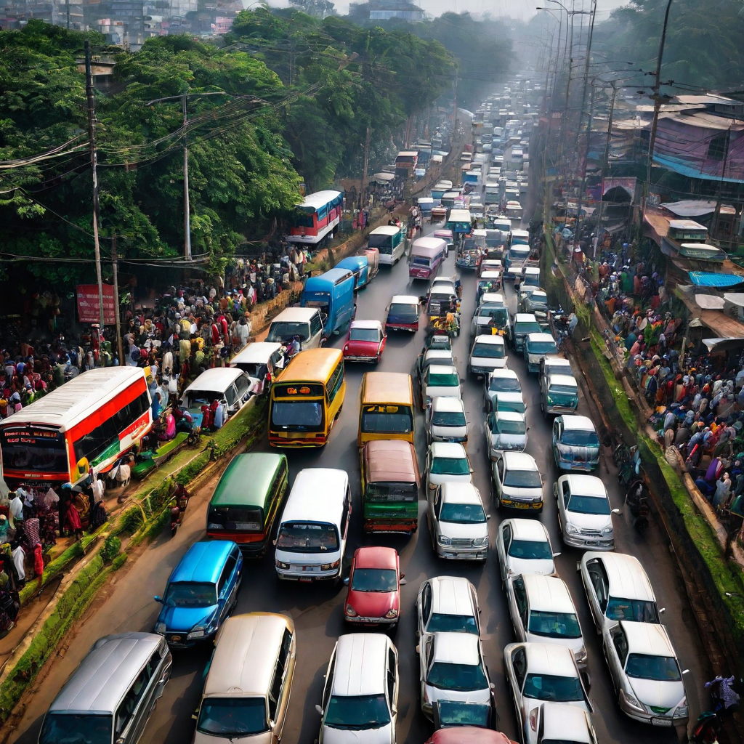
Abstract
This research delves into the complexities of urban traffic congestion, focusing on cities like Dhaka, where traffic issues lead to inconvenience, delays, and environmental harm. Using City Skyline within the Unity game engine, the study simulates Dhaka's traffic flow, employing microscopic models like the Intelligent Driver Model to represent individual vehicle behaviors. It explores diverse scenarios, including varying vehicle occupancy and different control mechanisms like traffic police and lights.
The primary goal is understanding traffic flow issues, identifying problem areas, and proposing effective solutions. Through experiments involving policy testing, lane configurations, and infrastructure constraints, the study aimed to optimize traffic flow. Leveraging City Skyline's capabilities, custom policies and dynamic interactions within the simulation were implemented.
Results yielded valuable insights into Dhaka's traffic dynamics, highlighting the impact of traffic control measures and law adherence. Heatmaps and visualizations underscored the efficacy of enforcing traffic laws and implementing traffic light-controlled systems in alleviating congestion.
In summary, the research advances our understanding of urban traffic dynamics and offers practical solutions for managing congestion. Despite simulation limitations, future enhancements targeting real-world factors like parked vehicles and pedestrian behavior could further improve the simulation accuracy.

Slide 4
Introduction
This research tackles urban traffic congestion, a major issue in cities like Dhaka, causing inconvenience, delays, and pollution. By simulating Dhaka's traffic using City Skyline in Unity, the study explores microscopic models, notably the Intelligent Driver Model, to understand vehicle behaviors. It delves into various scenarios, examining factors like occupancy, law adherence, and traffic control efficacy to identify congestion causes and propose solutions.
The goal is optimizing traffic within existing infrastructure limitations by testing different policies and lane configurations. Leveraging City Skylines modding capabilities, the research implements custom strategies, offering valuable insights into traffic flow factors.
Analyzing variables like traffic control and law adherence through heatmaps and visualizations, the study emphasizes enforcing laws and using traffic lights to ease congestion in Dhaka.
Ultimately, this research enhances understanding of urban traffic dynamics, suggesting practical ways to manage congestion. Acknowledging simulation limitations, it paves the way for future improvements in traffic flow simulations.

Slide 5
Why simulate Traffic Flow ?
The main reason behind simulating traffic flow is to generate data without real world. Instead of testing new ideas in real world we can simulate the traffic flow, test our new ideas there without having to interact with the real world. This helps accelerate the optimization and data gather of traffic systems. Simulation is much cheaper and faster alternative to real world testing. The few objectives of simulating traffic flow in Dhaka city are as follows:
To understand the traffic infrastructure in Dhaka city
The understand the causes and effects of traffic jams in Dhaka city
To find some effective solutions to traffic jams
Page - 04

Slide 6
Usefulness of traffic simulation
Traffic simulation is an important tool to enable planners to use available budgets and resources as efficiently as possible when expanding or reconstructing transportation systems. Simulation models help to understand the effects that different measures have on traffic volume and traffic flow under different circumstances. So, simulating traffic creates a solid basis for good and cost-effective decisions - making traffic and mobility safe, sustainable, equitable and resilient. In short, it helps to create future-oriented mobility. For example, the effectiveness of a flyover, bridge, tunnels or other systems can be measured using the traffic flow simulation and it helps take the most effective decision as possible and it also reduces unnecessary high costs of traffic projects. Traffic simulation also helps build more safer roads, flyover and other road stuffs.
Page - 05

Slide 7
Our plans
We have certain plans regarding this traffic simulation in Dhaka city such as -
Simulate traffic flow in major areas such as Mohakhali, Bijoy sarani, Banani to see how the number of traffics, speed, intersection affect traffic flow there.
To understand the cause and level of traffic jam.
To understand how to find some effective ways of solving traffic jam issue.
To understand how width of highway can affect traffic flow.
To gain enough knowledge from our simulation which we can use to find the ways of solving traffic jam.
Page - 09

Slide 8
Modeling
Traffic system models are classified into 3 categories such as -
Microscopic models - This represents every vehicle separately.
Macroscopic models - This describes the movement of vehicles as a whole in terms of traffic density and traffic flow.
Mesoscopic models - This is hybrid model that combines the features of both microscopic and macroscopic models. They model flow as “packets” of vehicles.
Page - 06

Slide 9
Literature Review
The passage emphasizes the criticality of traffic flow simulation in Dhaka, addressing the significant issues caused by poor traffic infrastructure. Dhaka's traffic woes result in massive congestion, substantial economic losses, and are detrimental to effective city planning and infrastructure development. The city experiences severe traffic conditions, especially during peak office hours, attributed to diverse vehicle types like buses, private cars, rickshaws, and three-wheelers. Rickshaws on highways notably impact traffic flow.
Regarding traffic flow simulation techniques, microscopic, macroscopic, and mesoscopic models are utilized, yet existing research doesn't specifically address Dhaka's unique traffic complexities. The absence of simulations for a city like Dhaka, especially considering non-compliance with traffic rules, led to a research gap addressed by the work discussed. The simulation demonstrates the potential outcomes of disregarding or partially adhering to traffic regulations, offering a distinct perspective on Dhaka's traffic conditions. Despite limitations in replicating Dhaka's exact environment, the simulation provides insightful albeit not entirely accurate results.
The simulation's significance lies in its utility for comprehending Dhaka's traffic dynamics, aiding in evaluating the impact of potential infrastructure enhancements like bridges, flyovers, and roads. The understanding derived could facilitate the formulation of solutions to alleviate Dhaka's severe traffic congestion, benefiting millions affected by the issue.

Slide 10
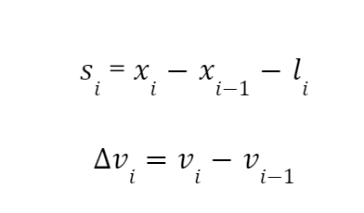
Microscopic model
Here si is the distance between two vehicles and vi is the relative velocity between i-th vehicle and i-1 - th vehicle.

Slide 11
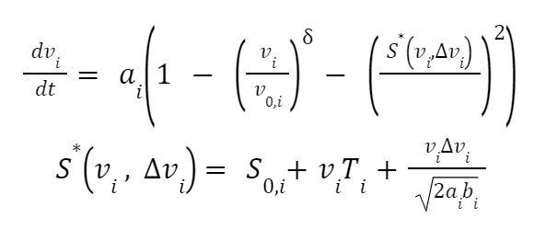
Intelligent Driver Model
The Intelligent Driver Model is a model that Treiber Hennecke invented in 2000. It explains how the i-th vehicle accelerates. The respective equation is as follows:
These parameters are as follows:
s0,i: is the minimum required distance between i-1 th and i-th
vehicle.
v0,i: is the maximum required speed of i-th vehicle
: is the acceleration exponent.
Ti: is the reaction time of i-th vehicle driver.
bi: is the comfortable negative acceleration for the i-th vehicle.
ai: is the highest acceleration allowed for vehicle i
S*: is the actual required distance between (i-1)th vehicle & i-th vehicle.

Slide 12
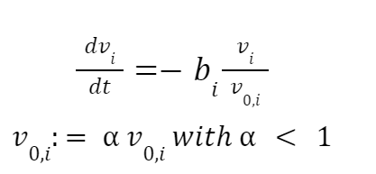
Traffic Road Network Model
We need to simulate a network of connected roads. We require the directed graph G = (V, E) for this.
V represents the set of nodes
The set of edges that stand in for roads is E.
Traffic Light
Traffic lights, which have two distinct zones, such as a stop zone and a slow down zone, are situated at vertices.
Stop Zone: The term "stop zone" refers to the space between stops for moving cars. This can be expressed using the following equation:
Slow down zone: A zone where vehicles slow down is defined by both a slow down factor and a slow down distance. This is made possible by the equation that follows:

Slide 13
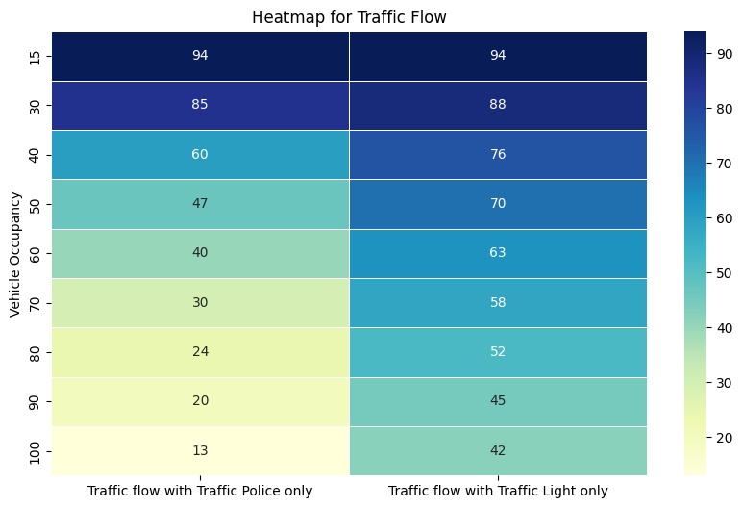
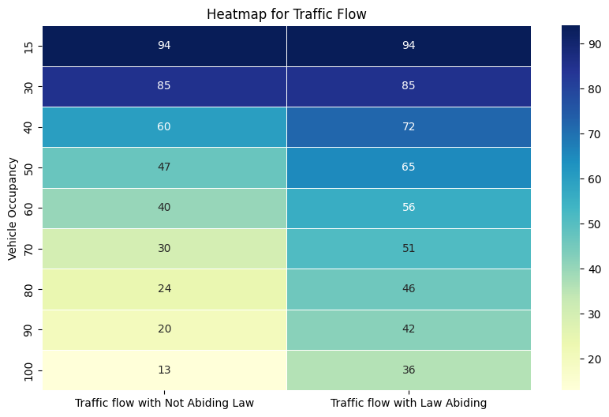
Result Analysis

Slide 14
Result analysis (continued)
After analyzing these simulated data it is visible that the causes of poor traffic flow leading to traffic jams are massive numbers of vehicles in peak hours with not enough roads, highways, poor law obedience by the pedestrians and drivers. It is also visible that traffic light controlled traffic systems are more efficient than traffic police controlled traffic systems resulting in better traffic flow when traffic light controlled traffic systems are used. So some of the solutions of poor traffic flow leading to traffic jams in Dhaka city are as follows:
Increasing number of roads, highways, making well spacious highways, roads with more lanes.
Traffic law should be strictly followed by both drivers and pedestrians.
Traffic light controlled traffic systems should be introduced to all traffic zones in Dhaka.

Slide 15
Related Research
1. Simulation Research on Traffic Flow Characteristics of Bus Stop Area Based on VISSIM Software - https://ieeexplore.ieee.org/document/8603540
2. Statistical traffic generation methods for urban traffic simulation - https://ieeexplore.ieee.org/document/8323712
3.. DynasTIM: A Real-time Online Traffic Simulation and Optimization System - https://ieeexplore.ieee.org/document/8996759
4. Simulation of Facilities That Ensure Adaptive Functioning of Urban Street and Road Network https://ieeexplore.ieee.org/document/9976581
5. Current Trends in Road Traffic Network Division for Distributed or Parallel Road Traffic Simulation - https://ieeexplore.ieee.org/document/9932112
Page - 07

Slide 16
Challenges
There are certain limitations and challenges of traffic simulation such as -
Challenges on model flexibility
Challenges on model look-ahead capability
Challenges on model expandability
Challenge of model consistency
Page - 08

Slide 17
Limitations and Future work
The limitations of this paper depends on the accuracy of the simulation and not being able to accurately simulate the conditions of Dhaka city. Certain things were not taken into account such as in some parts of Dhaka city and highways , vehicles are parked, street vendors block the sideways of roads which cause poorer traffic flow leading to traffic jams. Simulation of rickshaw (local form of transportation) behavior is complex and lacks data. The roads and highways are also blocked when VIP persons move in the city. This drastically reduces traffic flow. Such conditions were not applied in the simulation. This reduced the accuracy of simulated traffic flow. Further works can be done with these scenarios taken into account and optimizing the city in such a manner so that the simulated traffic flow can be the most accurate as possible.

Slide 18
Conclusion
In conclusion, this research paper dealt with the traffic flow simulation in Dhaka city which was simulated with our custom designed Dhaka city in City Skyline traffic simulator and then data was generated by running the traffic flow simulation where various datasets were generated depending on various types of input parameters. The generated data of the simulation were used to understand the traffic conditions of Dhaka city where it was possible to deeply understand the main causes of traffic jams in Dhaka city and some effective solutions were determined with those deeper understanding of how traffic flow changes based on certain parameters in Dhaka city. Traffic flow becomes poor in Dhaka city causing traffic jams during peak hours when the number of vehicles on highways , roads is at peak level. The poor obedience of traffic laws and not using traffic light controlled traffic systems were also responsible for poor traffic flow. Maintaining traffic laws strictly and use of traffic lights in all intersections will also increase traffic flow in Dhaka city which can solve the traffic jams in Dhaka city.
Page - 10

Slide 19
Thank you

